Slide 1
How to Get Started in AI
Brian Anderson, MS

Slide 2
For running on your own
Go to google colab in a chrome browser
https://colab.research.google.com/notebooks/intro.ipynb
Click ‘File’ -> ‘open notebook’
Click ‘GitHub’ tab and search brianmanderson
Select the Repository MD_Anderson_Intro_To_AI_Workshop
Click ‘Click_Me.ipynb’
Follow instructions to change Runtime to GPU

Slide 3
Overview
Machine\Deep learning in imaging
Convolutions!
Difference between deep and machine learning
Creating data from medical images (provided)
Things I wish I’d known

Slide 4
Imaging (Convolution Nets)
Machine\Deep Learning Style

Slide 5
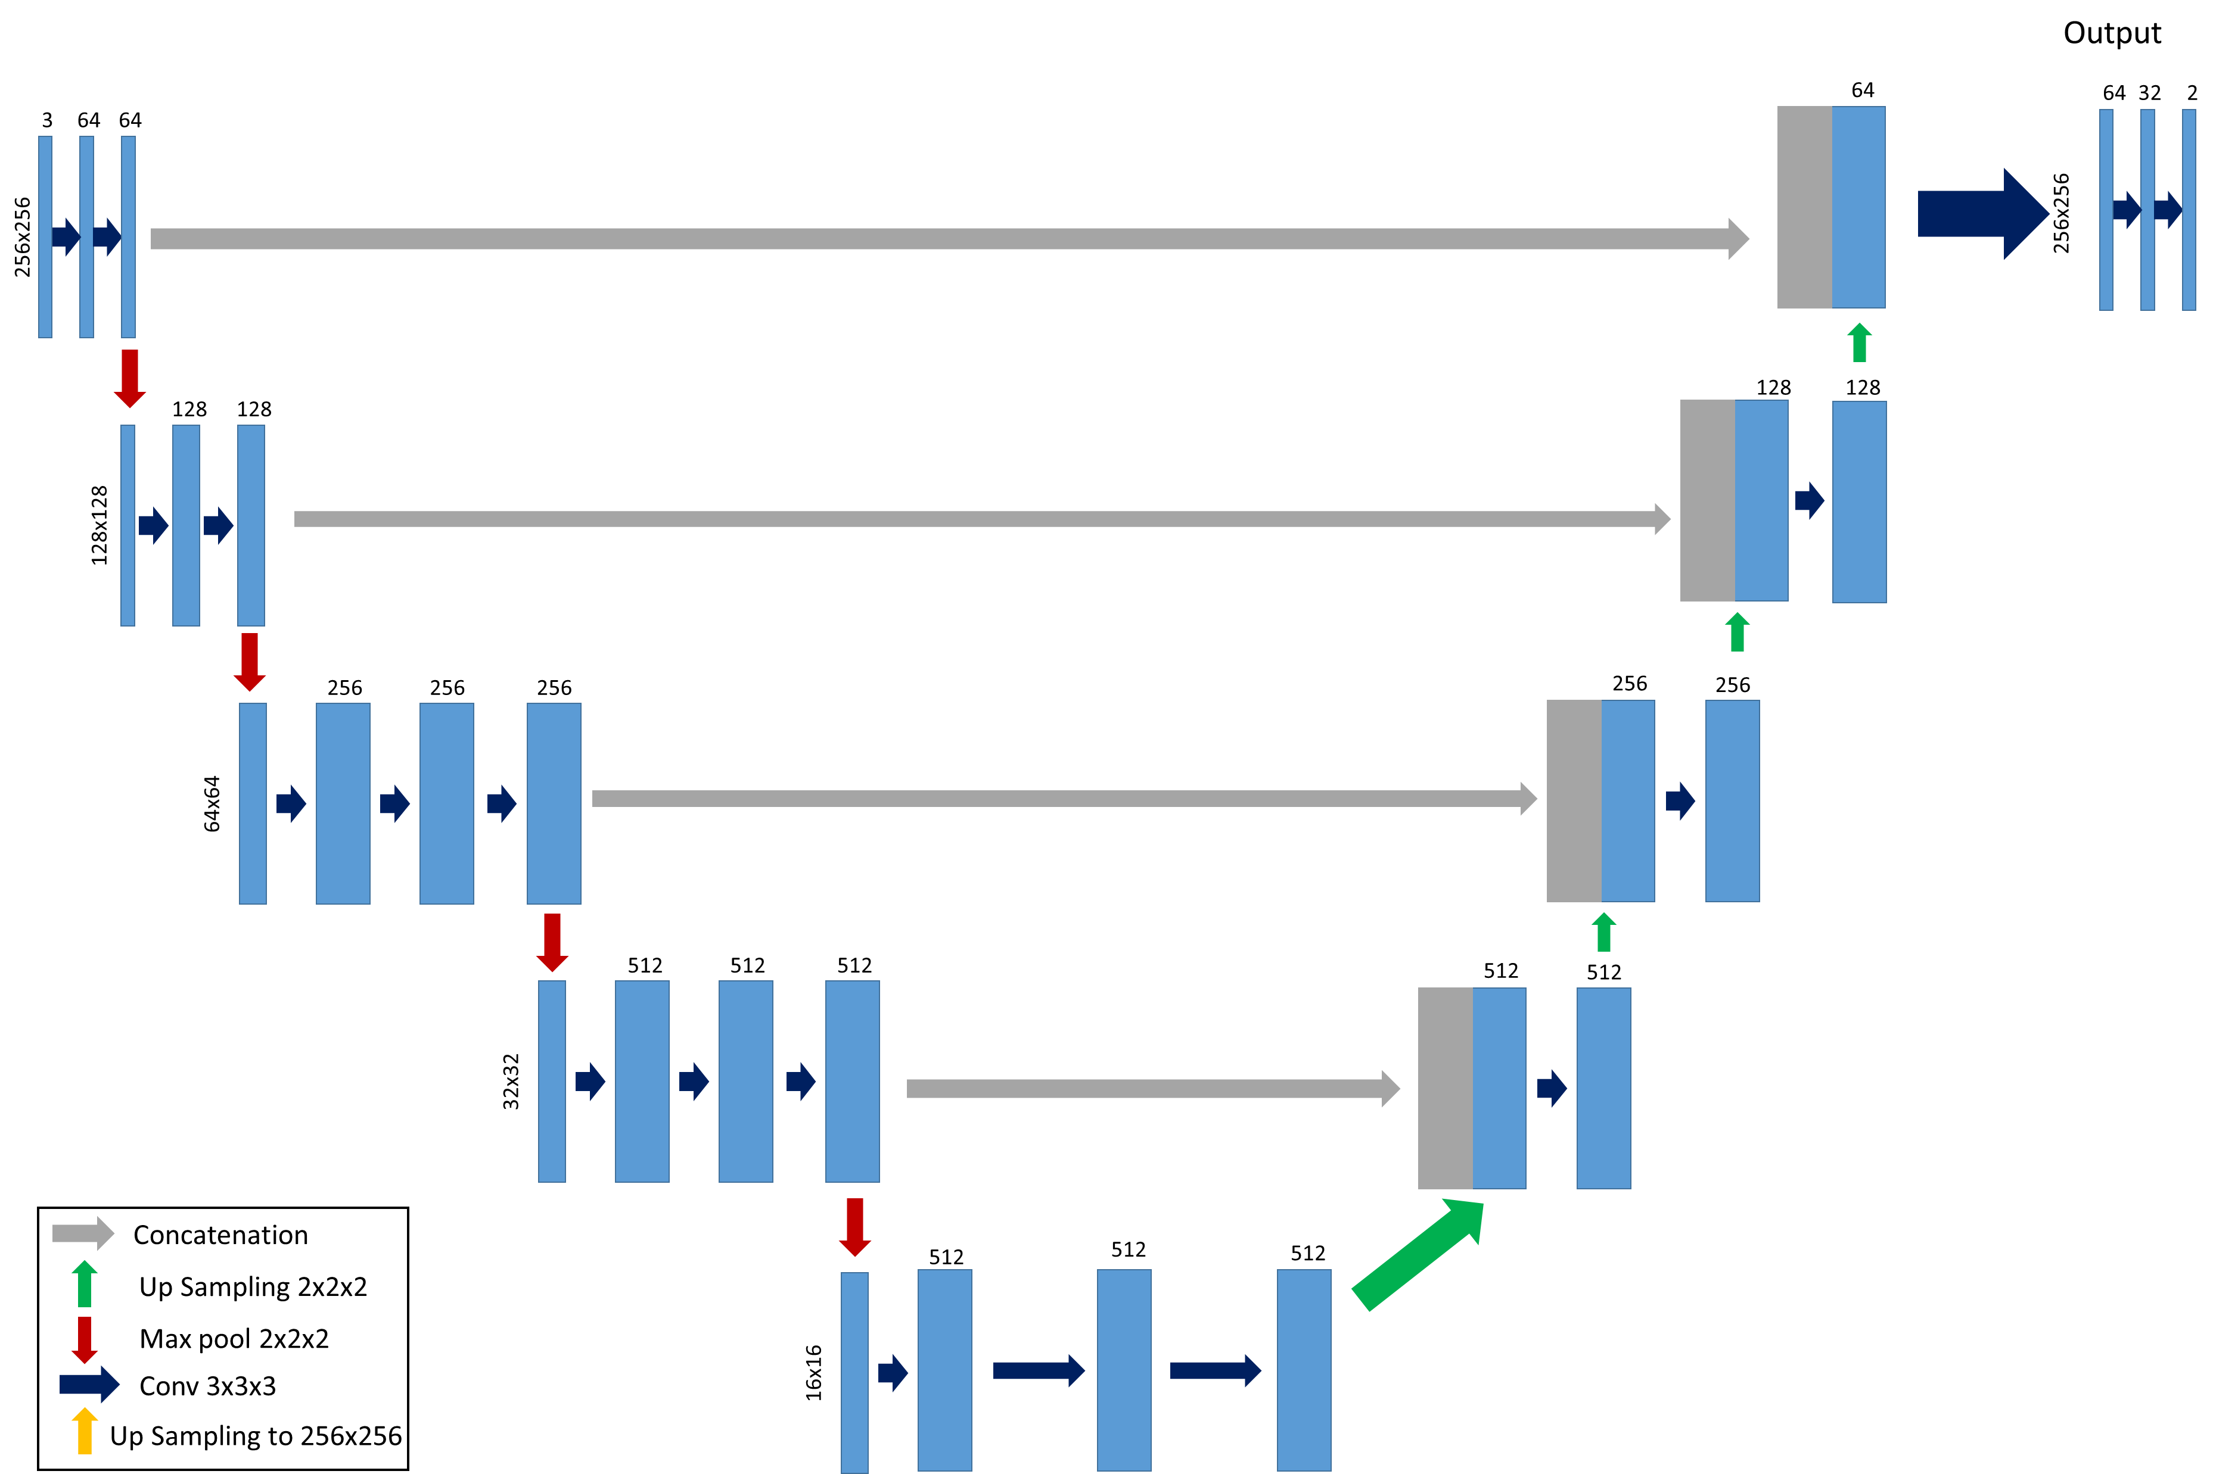
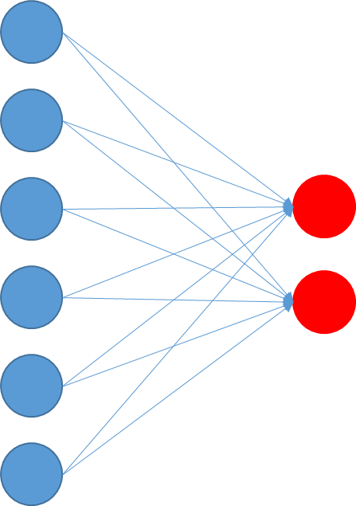
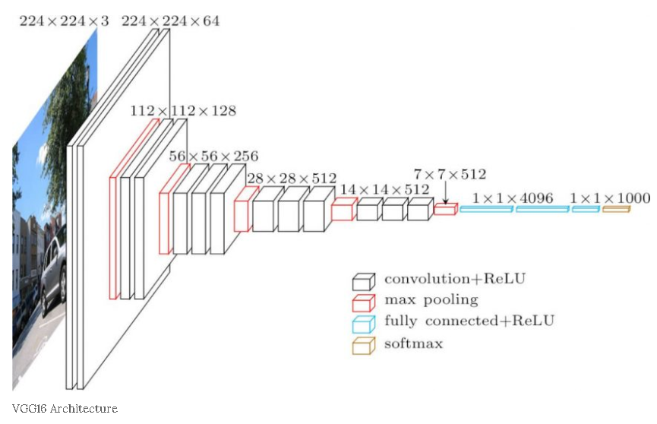
‘Main parts’ of convolution network
Convolution kernels
Activation
Pooling Layers
Fully-Connected Layers
https://neurohive.io/en/popular-networks/vgg16/

Slide 6
What is a convolution?
Kernels
This is a box!
Two horizontal and two parallel lines
Convolution
Activation
Max Pooling
Fully Connected

Slide 7
What is a convolution?
Kernels
This is a box!
Convolution
Activation
Max Pooling
Fully Connected

Slide 8
What is a convolution?
Kernels
This is a box!
Convolution
Activation
Max Pooling
Fully Connected

Slide 9
Why not just use a ‘box’ convolution?
‘Box’ Kernel
Convolution
Activation
Max Pooling
Fully Connected
Notes:
Reminder that this is convolving across!

Slide 10
Why not just use a ‘box’ convolution?
‘Box’ Kernel
Convolution
Activation
Max Pooling
Fully Connected
Notes:
Reminder that this is convolving across!

Slide 11

Activation
Convolution
Activation
Max Pooling
Fully Connected

Slide 12
Horizontal and Vertical…
Convolution
Activation
Max Pooling
Fully Connected

Slide 13
Max Pooling
Max value in a 2x2 region
Convolution
Activation
Max Pooling
Fully Connected

Slide 14
Max Pooling
Max value in a 2x2 region
Convolution
Activation
Max Pooling
Fully Connected

Slide 15
Max Pooling
Max value in a 2x2 region
Convolution
Activation
Max Pooling
Fully Connected

Slide 16
Max Pooling
Max value in a 2x2 region
Convolution
Activation
Max Pooling
Fully Connected

Slide 17
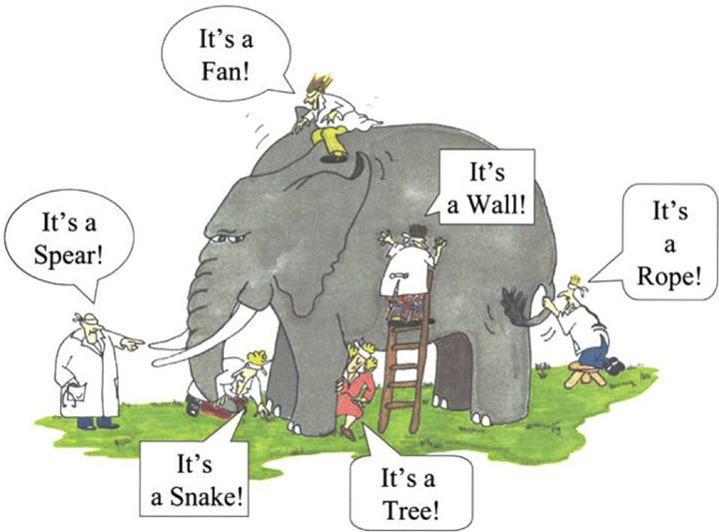
Fully Connected
Input layer
Output
“Lay” the voxels out
Elephant!
Convolution
Activation
Max Pooling
Fully Connected

Slide 18

Low specificity..
Also has two parallel lines…
Add four more kernels

Slide 19
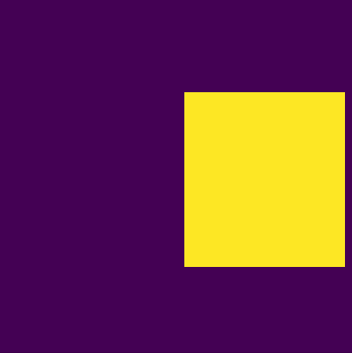

(Finally) Deep learning
Who knows what kernels are needed!
Why can’t the stupid computer figure it out…

Slide 20
First workshop – DeepBox

Slide 21
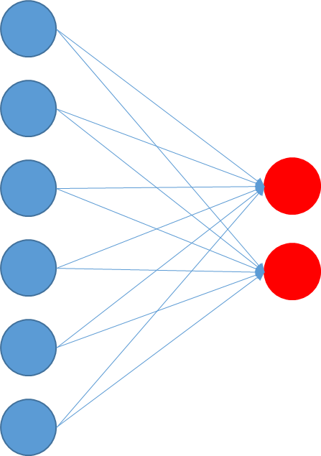
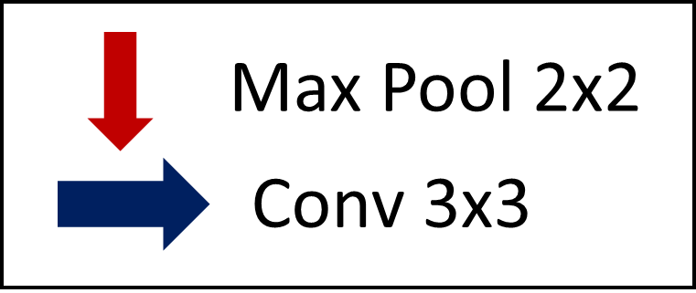
What’s the difference for deep learning?
We don’t set the kernels
Random initialization
1
4
Output
Input
Conv
64x64
FC (2 classes)
How does it learn?

Slide 22
Backpropagation!
1
4
Output
Input
Conv
0.6
0.4
Wrong output?
Change the decisions before it!
64x64

Slide 23
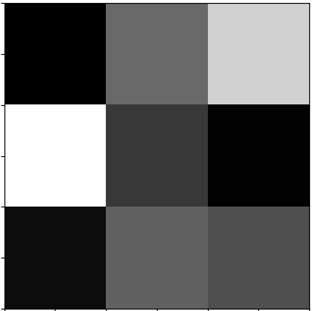
Comparison
Machine learning
Deep learning
Easy to understand kernels
Have to be clever…
Difficult to understand kernels
Works great!
Have to think about use cases
(Would a triangle be predicted as a rectangle or circle?)

Slide 24
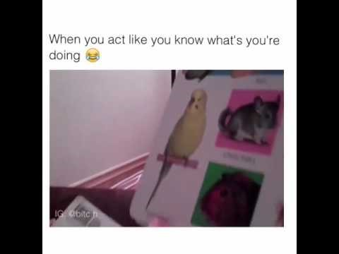
Comparison
Machine learning
Deep learning
Easy to understand kernels
Have to be clever…
Difficult to understand kernels
Works great!
Have to think about use cases
(Would a triangle be predicted as a rectangle or circle?)

Slide 25
Specifically into deep learning

Slide 26
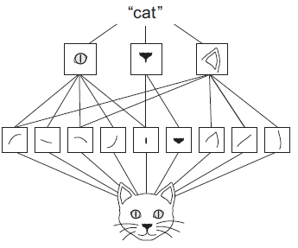
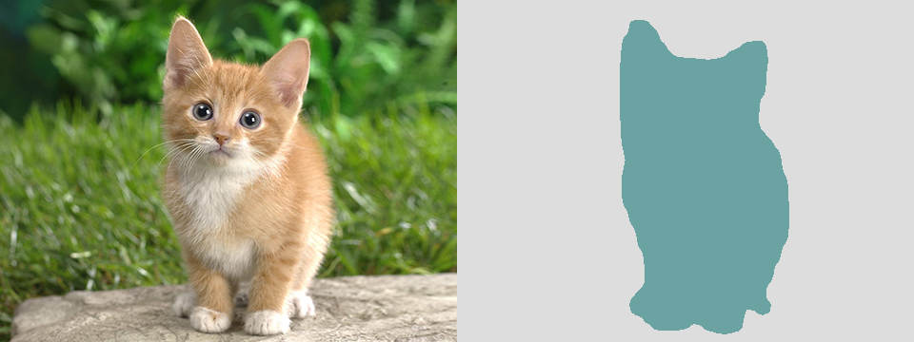



Quick overview
Cat
Max pooling
32x32 image
28x28 feature maps
Pool
Pool
5x5 kernel
Feet
Ears
Fur
Problem: Convolutions are locally dependent..
Notes:
5 minutes (11 total)

Slide 27

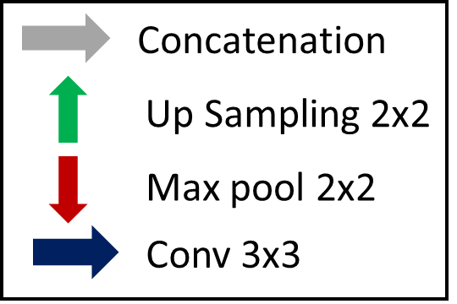

Auto-encoder/Decoder
Notes:
12 minutes

Slide 28
Second workshop – Liver model

Slide 29
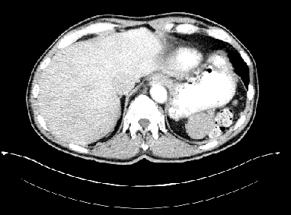
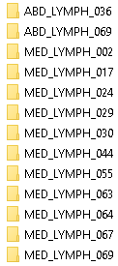
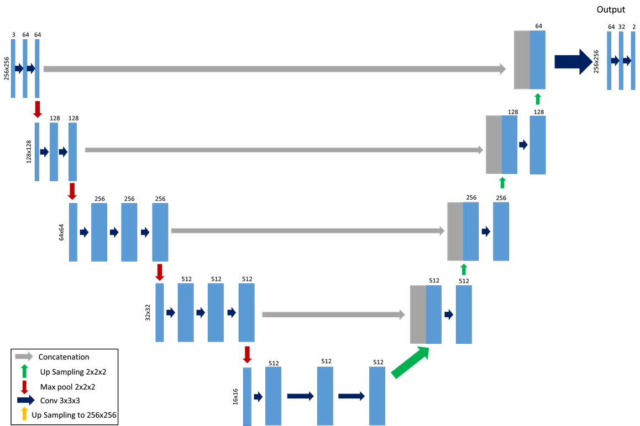
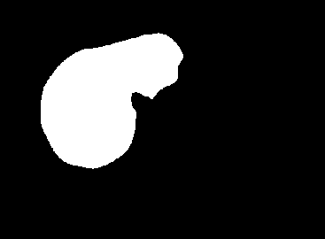
Biggest time sinks..
Roi names: Liver, liver, liver_bma, liver_9.15.10, etc.
Data curation!

Slide 30
Data Curation workbook

Slide 31
Now…
Regular UNet
What about pre-trained?

Slide 32
Liver Model
Workshop

Slide 33
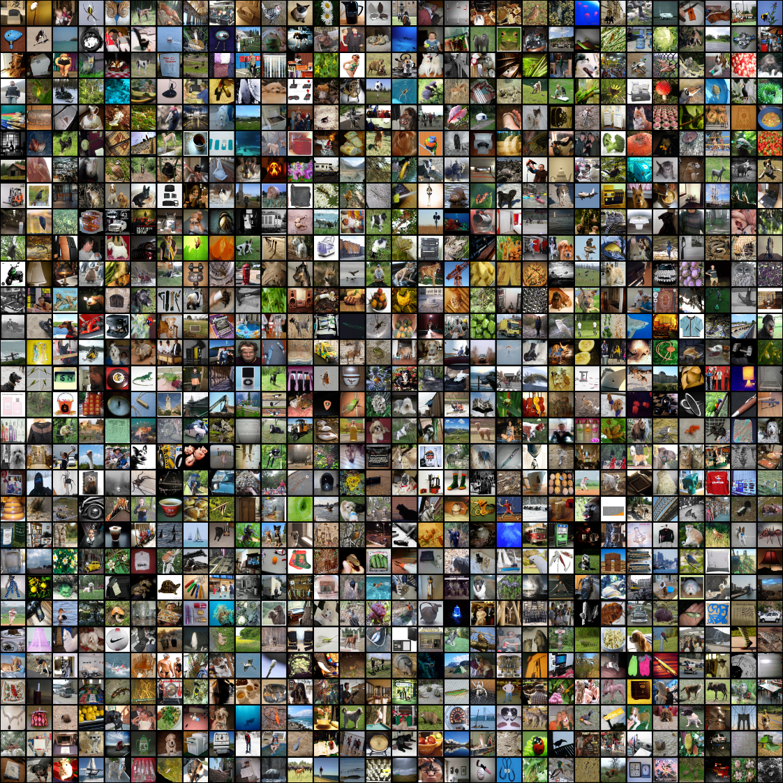
Visual Geometry Group (VGG)
ImageNet
~15 million, 22,000 categories
~ 1000 images in 1000 classes
Source Information | Image Distribution
Source | Training | Validation | Test
ImageNet | 1,200,000 | 50,000 | 150,000
http://www.image-net.org/synset?wnid=n02977438

Slide 34
Visual Geometry Group (VGG)
Cat
https://neurohive.io/en/popular-networks/vgg16/

Slide 35
Visual Geometry Group (VGG)
Goal
https://neurohive.io/en/popular-networks/vgg16/

Slide 36
Nuances of fine-tuning: what to re-train
VGG Pretrained
New
Protect these layers
Propagated loss undoes pre-training
Train
Training will first be bad..
All of ‘New’ is initialized random weights
Notes:
Ends on 5 minutes (15 total)

Slide 37
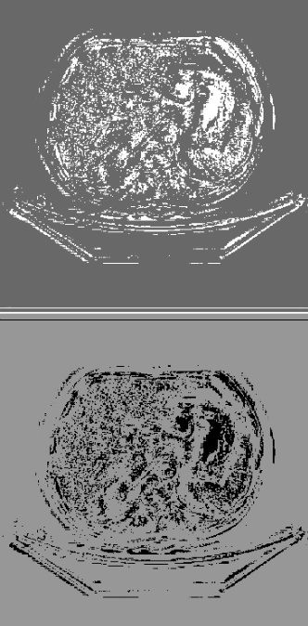
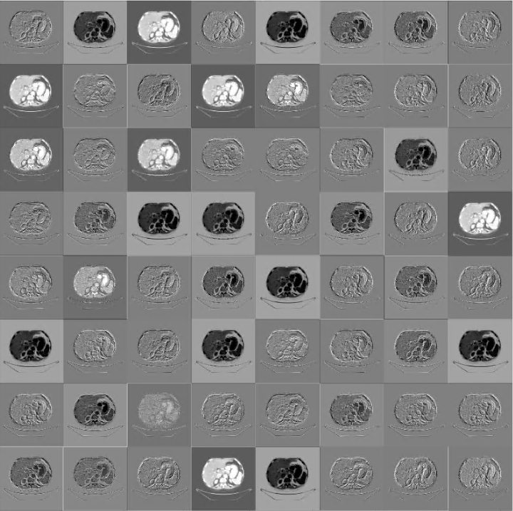
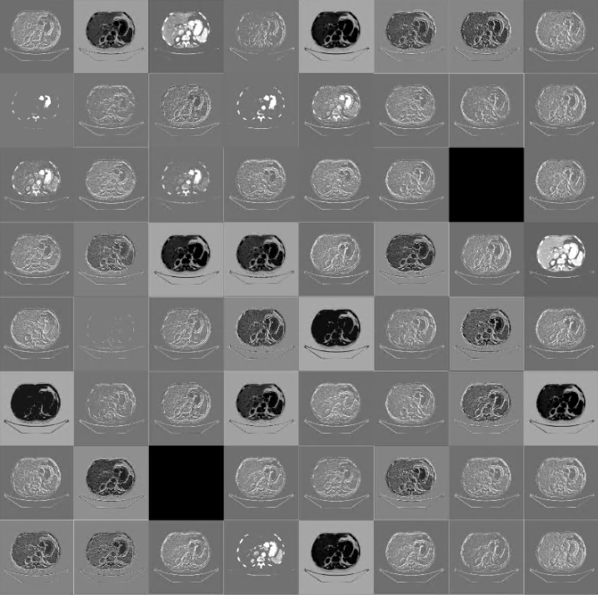
Outputs
Output
block1_conv1
block1_conv1_activation

Slide 38
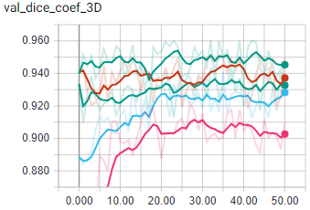
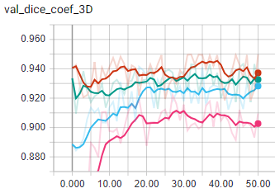
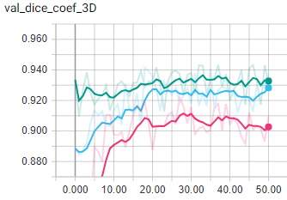
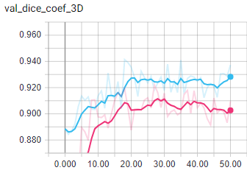
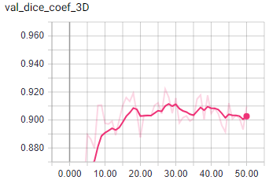
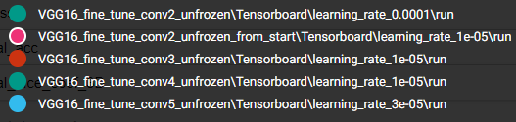
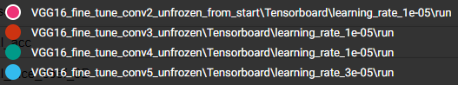
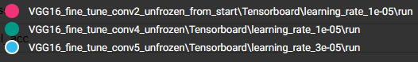
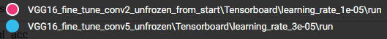
Nuances of fine-tuning: what to re-train
What’s best?

Slide 39
Making your own architecture

Slide 40
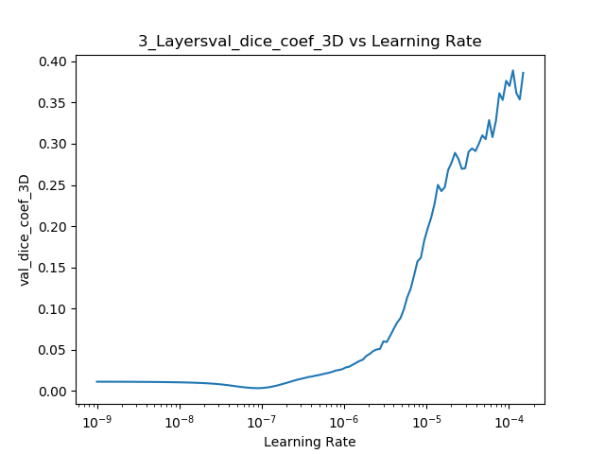
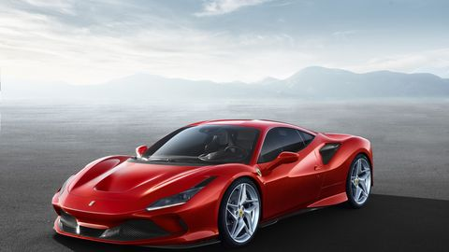

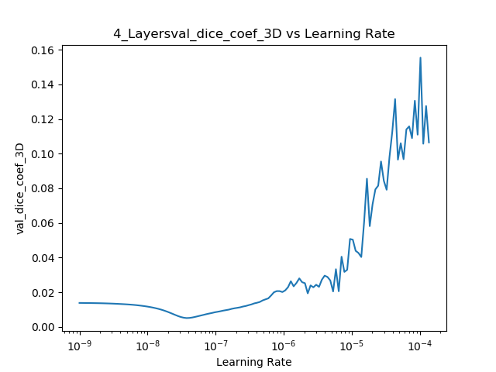
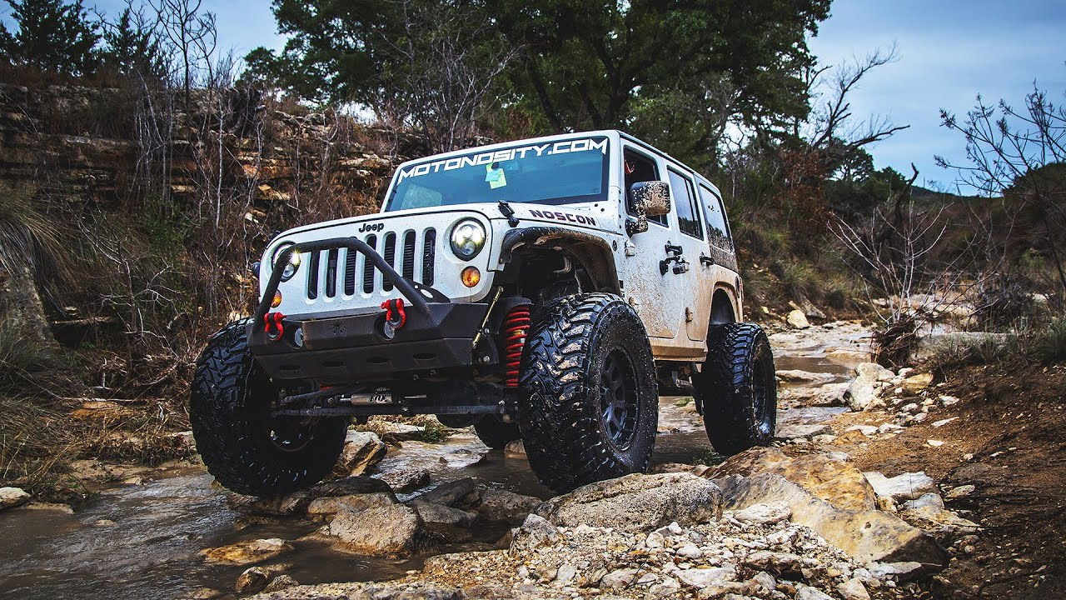
Optimization Searching
Things you can change…
Architecture
Layers deep
# Convolution blocks/# Features
Hyper-Parameters
Learning rate, loss, regularization
Start simple…

Slide 41
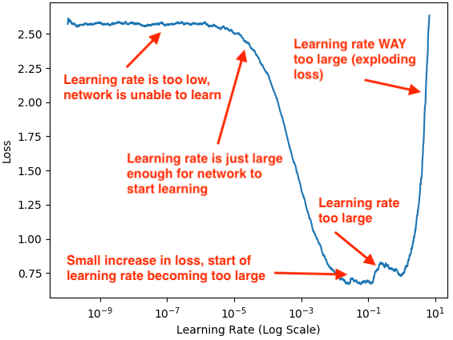
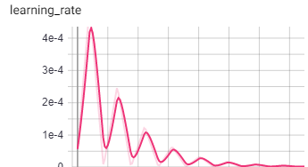
Finding a good learning rate
https://github.com/brianmanderson/Finding_Optimization_Parameters
Min Learning Rate
Max Learning Rate
Potentially largest wastes of time…
Gradually increase LR
Find min and max LR
Triangular Policy
Max LR
Min LR
https://www.pyimagesearch.com/2019/08/05/keras-learning-rate-finder/
https://arxiv.org/pdf/1506.01186.pdf

Slide 42
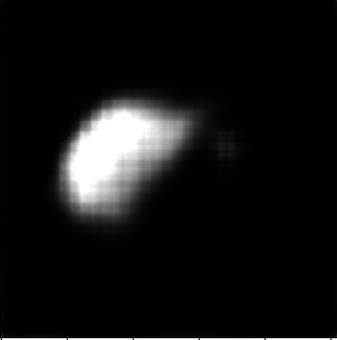
Inverse Transpose Artifacts

Slide 43
Important questions to ask

Slide 44

Important questions to ask
DSC = 1!
51%
Evaluating final algorithm
Using same loss as before? Dice?
What is your loss metric?
Dice, Categorical cross entropy
51%
Doesn’t mean Dice is bad!
Need other metrics with it

Slide 45

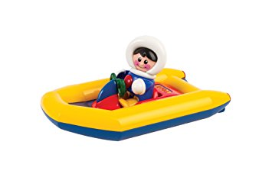

Important questions to ask
2 Classes
Boat
Not-Boat
https://en.wikipedia.org/wiki/Ocean
https://www.amazon.co.uk/Tolo-Toys-First-Friends-Dingy/dp/B008PO666U
Notes:
Let me explain for a second the important of weight balancing. So lets say we have this picture of the ocean, and I want to have the algorithm identify a boat. If our boat is really tiny, the algorithms’ only job is to minimize it’s loss. So, if 99% of the image is ‘not-boat’ it can get a really good accuracy just by saying ‘everything is not a boat’

Slide 46
Important questions to ask
DSC = 1!
51%
Evaluating final algorithm
Using same loss as before? Dice?
What is your loss metric?
Dice, Categorical cross entropy
WITHHELD TEST SET?!
Qualitative assessment?
51%
Doesn’t mean Dice is bad!
Need other metrics with it
Training | Validation | Test

Slide 47
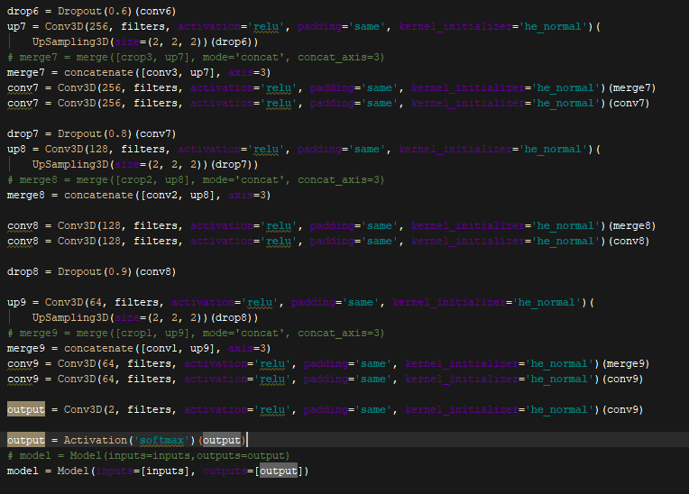
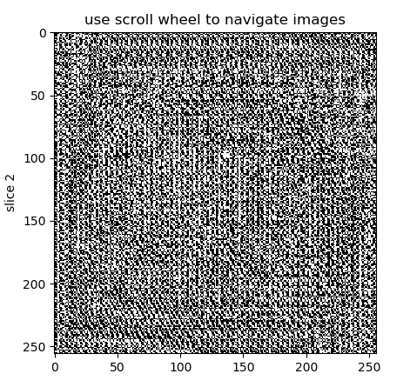
Oops
Accuracy: 0.92
Prediction

Slide 48
Important questions to ask
DSC = 1!
51%
Evaluating final algorithm
Using same loss as before? Dice?
What is your loss metric?
Dice, Categorical cross entropy
WITHHELD TEST SET?!
Qualitative assessment?
What optimizer are you using?
Adam, SGD, (maybe RAdam)
51%
Doesn’t mean Dice is bad!
Need other metrics with it
Training | Validation | Test

Slide 49
Acknowledgements and Thanks
Brock Lab Group
Kristy Brock, PhD
Molly McCulloch, PhD
Guillaume Cazoulat, PhD
Ezgi Kirimli, MD
Bastien Rigaud, PhD
Yulun He
Anando Sen, PhD
Sara Thrower, PhD
Anne-Cecile Lesage, PhD
Brandon Reber
Court Yard Group
Eugene Koay, MD
Rachel Ger, PhD
Skylar Gay
Casey Gay
Joy Zhang, PhD
Callistus Nguyen, PhD
Constance Owens
Dong Joo Rhee, MS
Yvonne Roed, PhD
Laurence Court, PhD
Kelly Kisling, MS
Carlos Cardenas, PhD
Tucker Netherton, DMP
Rachel McCarroll, PhD
Jinzhong Yang, PhD
Luciano Branco
Odisio Lab Group
Bruno Odisio, MD
Ethan Lin, MD
Committee
Kristy Brock, PhD
Laurence E Court, PhD
Erik N.K. Cressman, MD, PhD
Ankit B Patel, PhD
Carlos C Cardenas, PhD
Thank you!
www.Github.com/BrianMAnderson
bmanderson@mdanderson.org
*undecided

Slide 50
https://media.giphy.com/media/st83jeYy9L6Bq/giphy.gif (peter throwing blinds ‘tweaking neural network’)
https://www.youtube.com/watch?v=bnJ8UpvdTQY (kid can’t say animal names)

